Slide 1
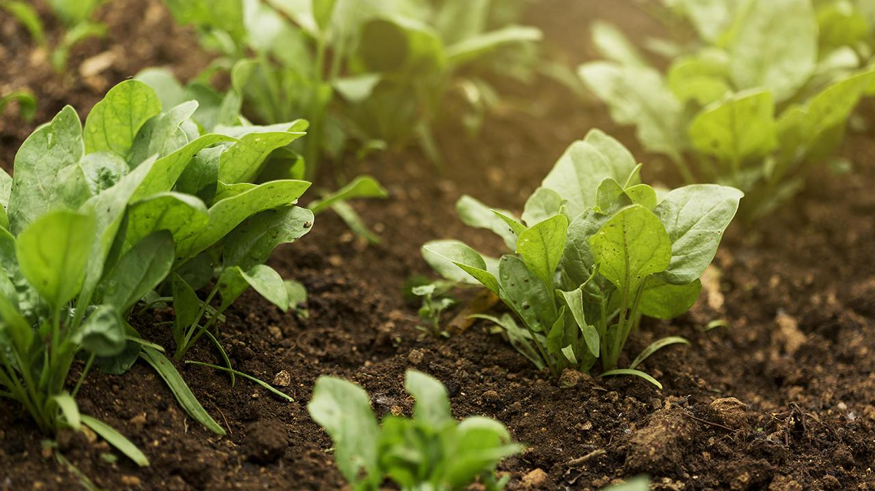
Smart Agriculture Irrigation System
DEPARTMENT : COMPUTER SCIENCE AND ENGINEERING
GUIDE : MR. MD.CHAN BHASHA
BATCH : A7
NAMES : C. GOWTHAM SAI RAM – 20J25A0501
G. NANDINI – 20J25A0503
K. SAI PREETHAM – 20J25A0504
B. ROHITH GOUD – 18J21A0523

Slide 2
Title Justification:
The main aim of this project is to create a IOT based Automatic Irrigation Design.
This Project is totally based on IOT.
With the help of sensors it work specifies the moisture level sensing of the crops and supplies the required water when needed.

Slide 3
Abstract
Agriculture is said to be the most inspiring occupation, irrigation or watering the field is considered the most challenging task in agriculture. There are various kinds of irrigation techniques available depending upon the terrain, Soil and availability of resources. Some of the watering system are drip system, nozzle types, tube methods, sprinkler systems ect.. IoT in agriculture uses robots, drones, remote sensors.The intention of this project is to create a IoT- based Automatic irrigation design. The Automatic irrigation structure is based on IoT technology means of managing the pump for water storage of groundwater to the farmers field and tracking the soil humidity pressure and temperature conditions of a farm field. The work specifies the moisture level sensing of the crops and supplies the required water when needed. The components included in this work are Microcontroller, GSM Module, Humidity Sensor and soil moisture Sensor.

Slide 4
INTRODUCTION
India's population crossing 1.3 billion in 2016
So balance between the optimum population growth and a healthy of nation is far to be achieved.
The rising population need for increased agricultural production
Irrigated agriculture has been important source increased agricultural production.
“IOT based Smart Agriculture Irrigation System” is to create an IOT based automated irrigation mechanism which turns the pumping motor ON and OFF pass command through IOT platform.
The main objective is to automatic the process of watering to the plants. The Various parameters of soil and plant are also sensed by using different sensors.
This reduce the manual work. Farmers need not starin themselves in maintaining and preventing the plans. This saves both electricity and water.

Slide 5
EXISTING SYSTEM
An Irrigation System for Smart Agriculture Using the Internet Of Things
This is mainly applied to agricultural field it can help the farmers for healthy plants
The existing system only checks the soil water stress and automates the process of watering.

Slide 6
Disadvantages of Existing Systems
The smart agriculture needs availability of internet continuously.
Moreover internet connection is slower
Failure of one component results in malfunction of the system
When there is no power supply, the system cannot send signals and process the irrigation system.
Repeated monitoring is required

Slide 7
PROPOSED SYSTEM

Slide 8
.
The temperature sensor is an electronic component which measures the temperature of its surroundings.
The “soil moisture sensor” is a sensor that is used to find out the water content in the soil. It contains two leads which are to be inserted into the soil to measure the water content in the soil.
A motor is used for powering the impeller which is basically designed for rotating and pushing the water outside.
Blink is a cloud platform designed to display, respond and interact with the projects data. It acts as a MQTT broker. It supports MQTT protocol; “Message Queue Telemetry Transport protocol

Slide 9
(MQTT) is basically a light weighted protocol used for device communication”. Using the MQTT library, users will be able to publish to the feeds as well as subscribe to the feeds; and at the same time they can send the data to the feeds or receive the data from the feeds.
The MQTT broker publishes the values to the subscribed clients which are basically any subscribed devices like smartphones or computers. The subscribed clients can monitor the values published by the broker. The DC water pump is pre-programmed to auto-irrigate the field as per the given limits of the soil moisture given at the source code and it can also be controlled from Blink through an ON/OFF switch mechanism provided in the dashboard

Slide 10
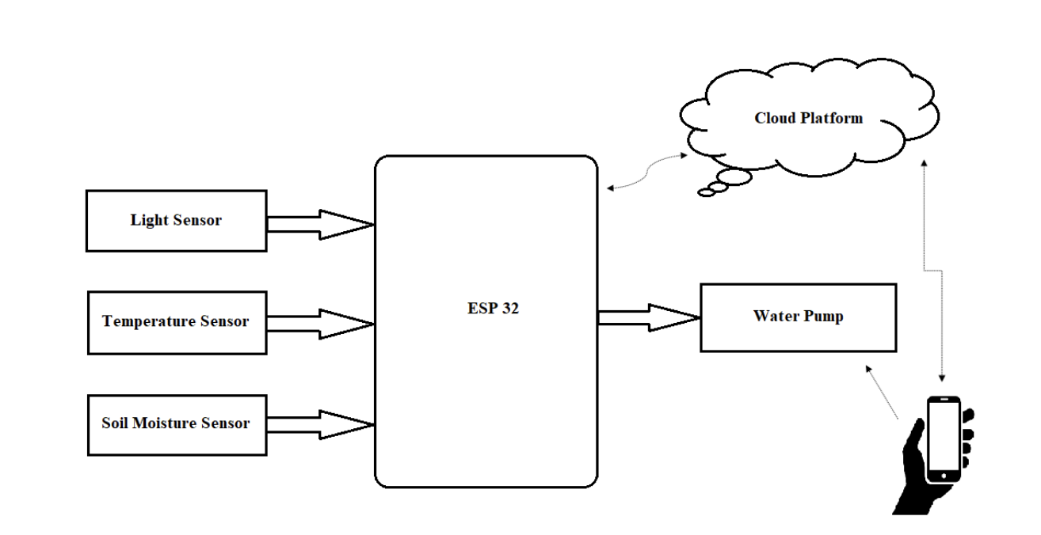

Slide 11
ADVANTAGES OF THE PROPOSED SYSTEM
Smart Irrigation System deliver exactly the amount of water that is needed.
Reduce soil erosion & nutrient leaching
Lowered Operation Costs
Efficient, economical & Saves Time
The sensor will be automatically off by that it will prevents overwatering that can harm your lawd and plants

Slide 12
System Requirements
Software Requirements
Arduino
Blynk App
Hardware Requirements
Esp32
Connected Farm
Wi-Fi module / GSM Module
Soil Moisture Sensor
Temperature Sensor

Slide 13
MODULES
Sensing the outer environment temperature: In this Thermistor 103 is also a one of the part of temperature sensor. This can sense room temperature and atmosphere temperature. This helps us to identify the temperature of the particular area where plant can grow.
Sensing the water content of the soil: In order to get an accurate measurement, a moisture sensor is also needed for calibration. The moisture sensor senses the water content of the soil. If the moisture content in the soil reduce to 1000, the relay switches on the pump motor.
Sensing the outer Environmental Humidity: When the moisture content in the atmosphere is low, the relay switches on the pump motor.

Slide 14
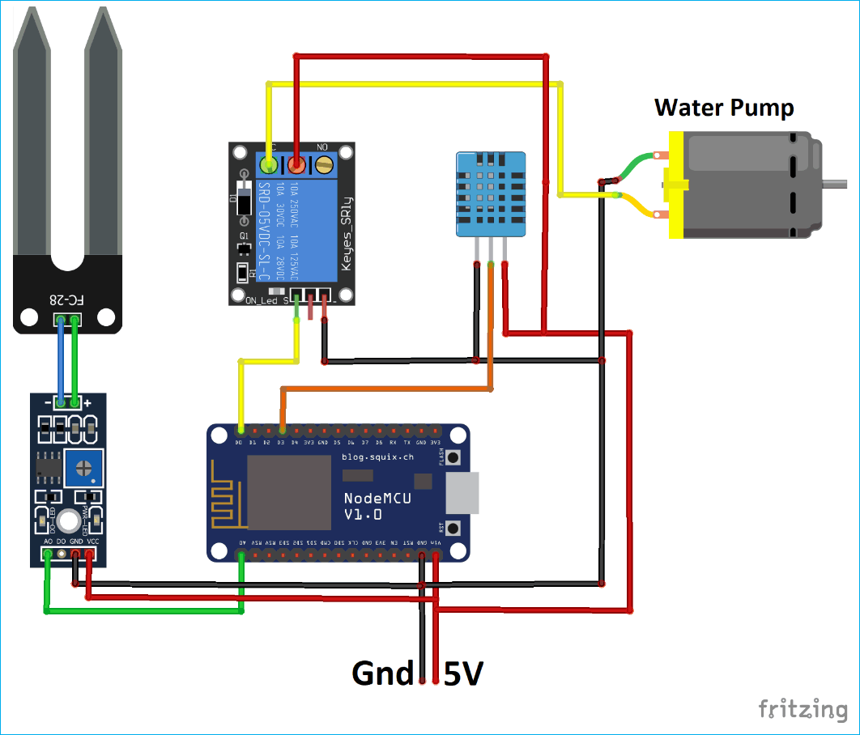
Architecture

Slide 15
Algorithm Explanation
STEP 1 :Declare variable for various sensors such as humidity, moisture and temperature
STEP 2 : By using set and also for LCD pins up() function set cursor at specific row and column for
Displaying Various words
STEP 3 : Set both input and output pins in pin mode.
STEP 4 : Use void loop ( )
STEP 5 : The function to repeat the process. humidity output values of moisture, temperature and are
Displayed in analog, degree Celsius and percentage respectively.
STEP 6 : Map () function is used to convert the analog values in to degree celcius and percentage.
STEP 7 : Serial print is used to print the output on the screen and led. print is used to print it on the lcd.
STEP 8 : If moisture is greater than 1000 or if temperature is greater than 40 degreecelcius the motor
Switches on.
STEP 9 : Else the motor automatically switches off the flow of water.
STEP 10 : Void Serial_ send( ) is used to send the output to the WIFI modem.

Slide 16
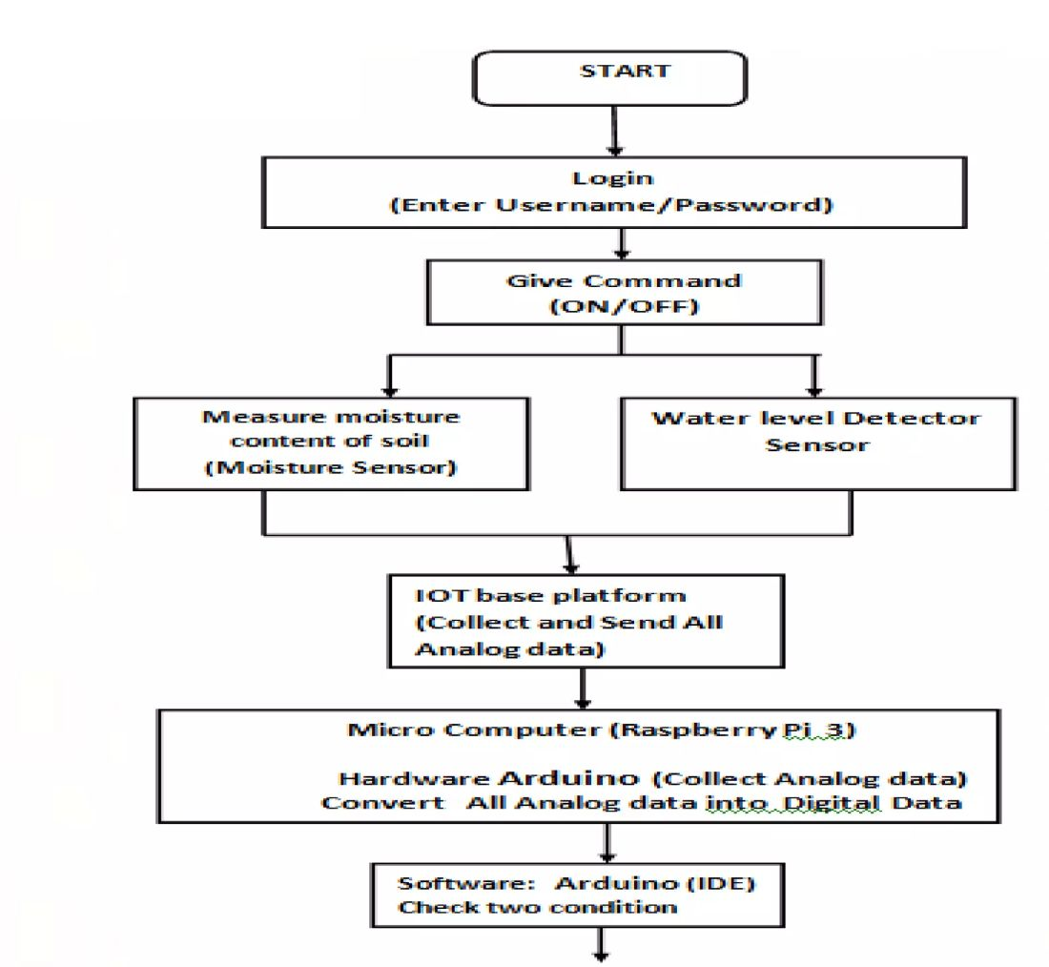
UML Diagrams
(Control Flow Diagram)

Slide 17
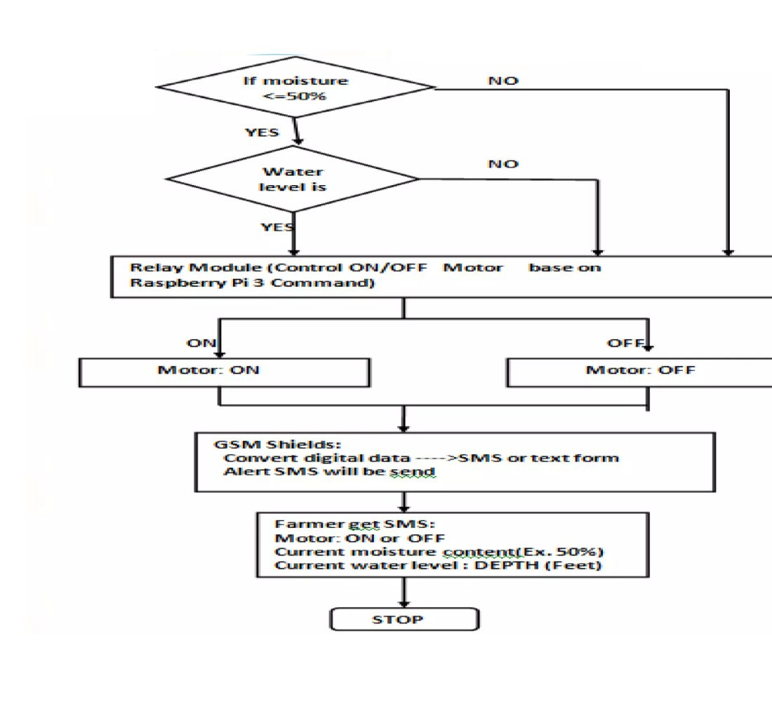

Slide 18
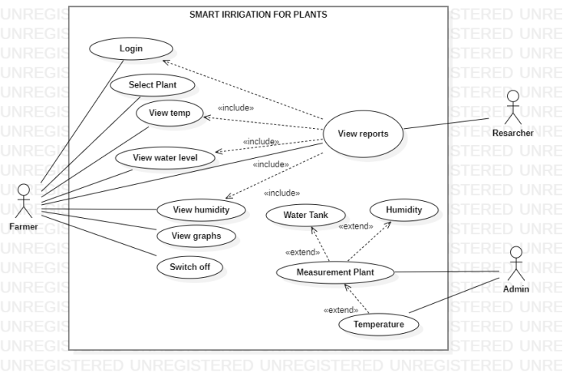
Use Case Diagrams

Slide 19
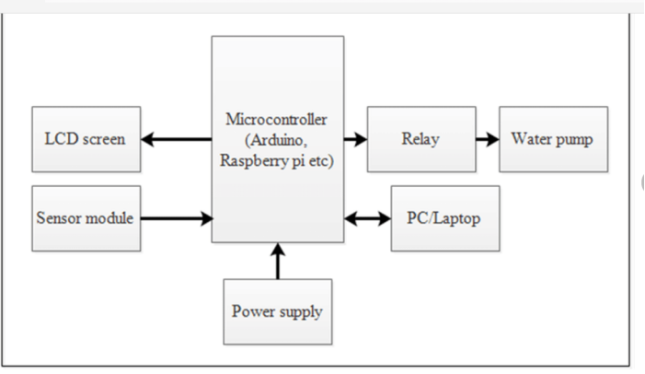
Object Diagram

Slide 20
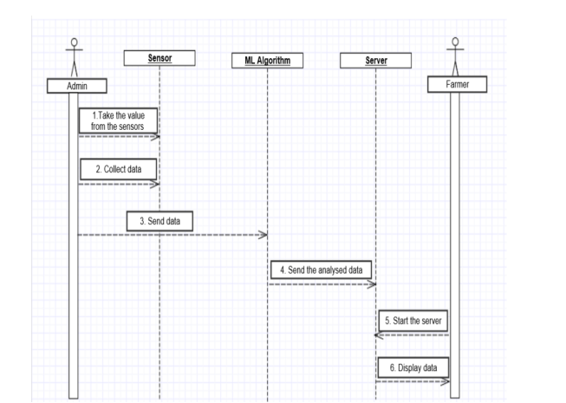
Sequence Diagram
Blynk app

Slide 21
Testing
Unit Testing:Unit testing Focuses verification efforts on the software design,the module. This is known as “Module Testing”. The module are tested separately.This testing carried out during programming stage itself.
Integration Testing:Integration testing is systematic testing for construction the program structure while at an equivalent time conducting test to uncover errors related to with in the interface. The objectives is to require unit tested modules and build a program structure.
Software Testing: System testing is that the stage of implementation that”s aimed towards ensuring that the system works accurately and efficiently for live operation commences. Testing is significant to the success of the system. System testing makes a logical assumption that if all the parts of the system are correct then goal are going to be successfully achieved.

Slide 22
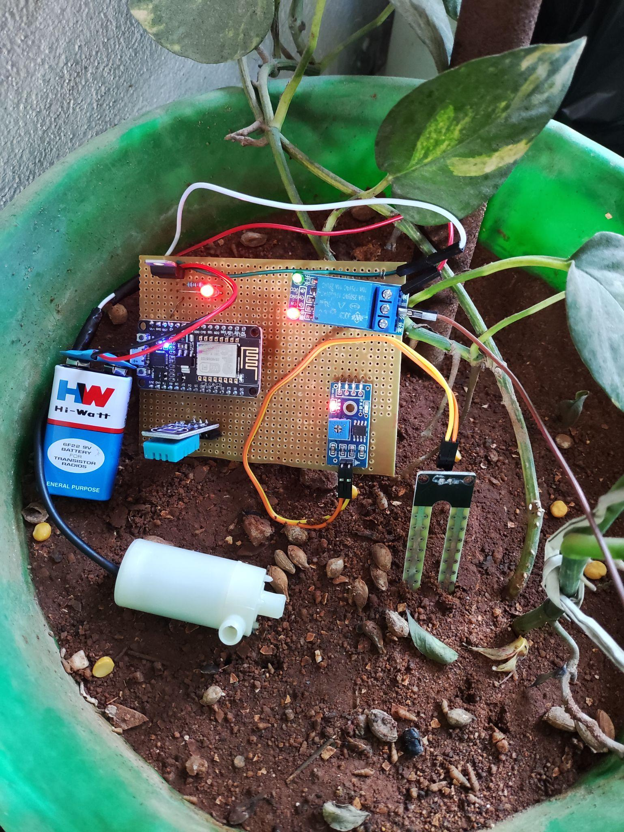
INPUT SCREEN

Slide 23
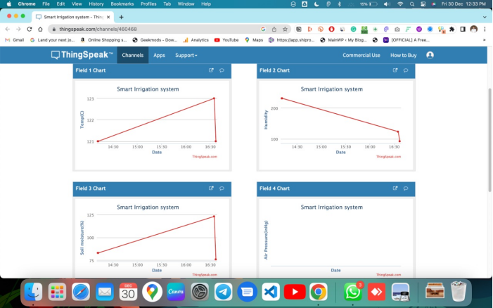
Output Screen

Slide 24
Conclusion
The significance of this paper is that manual world is reduced, and watering is automated. Healthy plants can be grown with limited use of water and electricity. Even elderly people can easily do farming. IOT plays a major role in agricultural field. This paper is mainly applied to agriculture field. The paper as been used to grow a tomato plant and it was successfully farming. Increase in agriculture also helps us to increase the economical state of the country.

Slide 25
Thank You

